Slide 1
Child Poverty Measurement Strategies:
Including Gendered & Intrahousehold analyses.
Sabina Alkire

Slide 2
Child Poverty
Poverty is disproportionately about children. They comprise nearly a third of the world’s population, but half of all of the multidimensionally poor people.
Tony Lake, UNICEF
Global MPI 2018:
Half the world’s poor people are children under 18.
We have more poor children on the planet than ever before

Slide 3
Why Measure?
In order to inform action to end poverty
This is the same for National Poverty
and for
Child Poverty
Both use MPIs. How can we build in a synergy?

Slide 4
Observations and Challenges
A Child MPI should not compete with a National MPI. Rather, a child focus should synergise & activate action.
Linking Child Poverty to a National MPI may be higher impact than building a stand-alone Child MPI:
National MPI is already understood, used, official
Strategic Analyses leads to an Integrated approach:
Inserts a ‘child’ focus into standard conversations
Adds gender, age, intra-household information.
Sometimes: enrich the MPI with a linked in-depth
Child MPI.

Slide 5
Child Poverty & National MPI: 4 Strategies
Include key Child Indicators in National MPI
Always Disaggregate the National MPI by age
Do Intrahousehold Analysis of MPI (age, gender)
Use a Child MPI that directly links to National MPI

Slide 6
Include key Child Indicators in National MPI
Examples:
School Attendance
Correct Grade for Age (Rezago)
Not in Education Employment or Training-NEET
Malnutrition
Child Labour
Can also be a Childhood and Youth Dimension

Slide 7
Always Disaggregate National MPI by age
Usually possible to disaggregate 0-17, 18+
Two key points:
Compare level of MPI/H for children vs adults
What % of all poor people are children.
Note: Both depends upon the structure of MPI

Slide 8
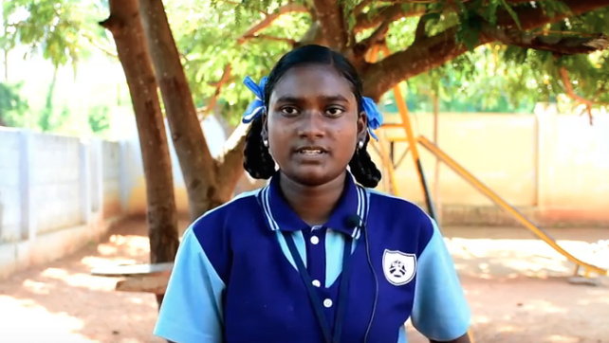
Key Finding: Nearly half of the MPI poor people are Children
Interviewed by students of Lady Doak College

Slide 9
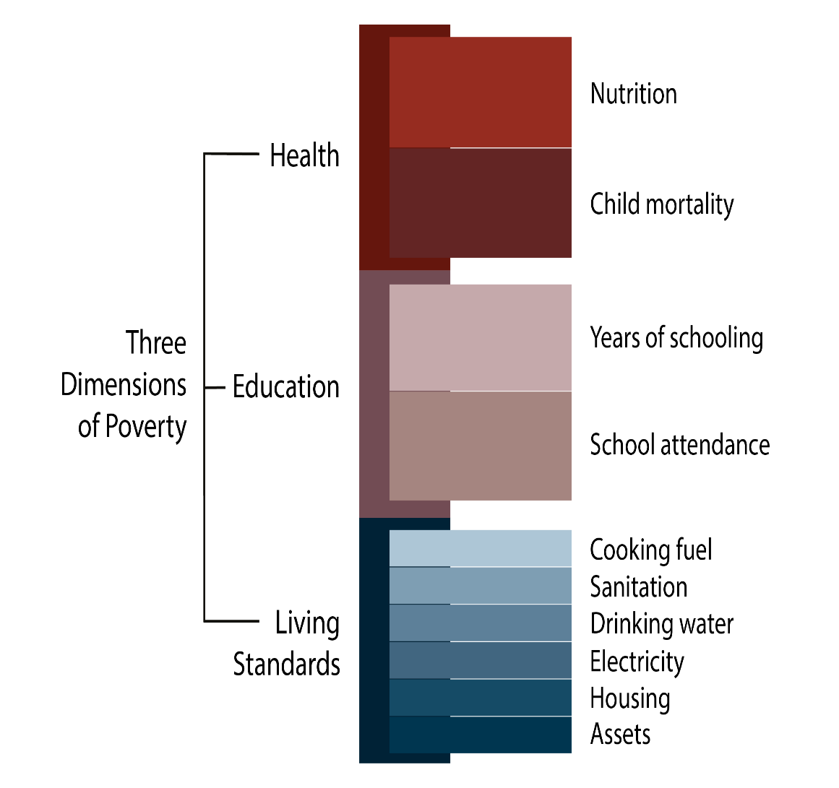
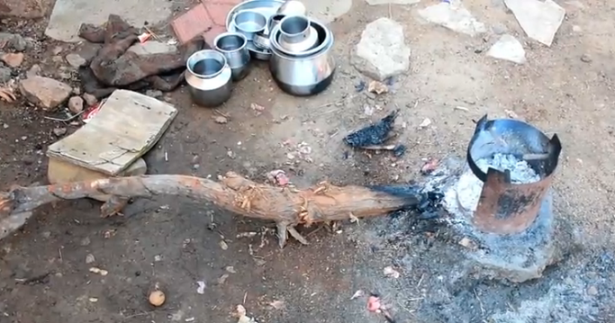
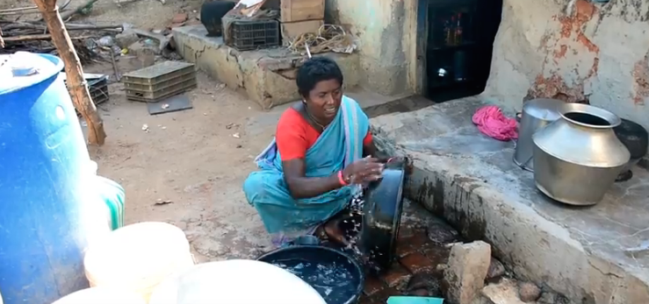
14-year old Amutha, India
She is deprived in nutrition + 5 living standard indicators.
Amutha is poor: she and her family are deprived in 44.4% of weighted indicators.

Slide 10
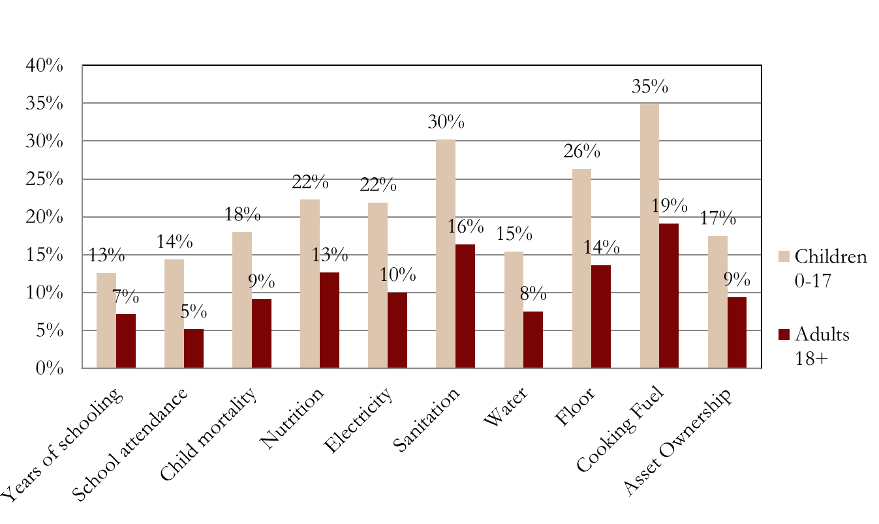
Age Disaggregation: Global MPI 2018:
34% of children are MPI poor, vs 18% of adults: One out of every three children – 34% – are multidimensionally poor, whereas it’s one out of six of adults.
How are they poor vs adults? (global MPI 2017 below)

Slide 11
Gendered, Intrahousehold Analysis of MPI
Which MPI variables draw on individual child data?
Restrict the sample to children
Go back to micro-data and analyse it:

Slide 12
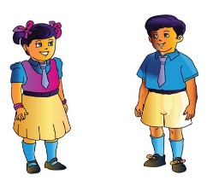
Children:
0-4 years
10-17 years
6-14 years

Slide 13
Telescope inside the MPI households
Who is malnourished – all children? More girls? What age?
Pioneer Children: Who has finished 6 years of schooling – in hh where no adults have?
Who is out of school – all children? More girls? What age?

Slide 14
Question 1: Poverty Status
What Percentage of Deprived Children are MPI poor
Children Out of School
MPI Poor Children
25%
30%
22%
both
Is School Attendance a good proxy for MPI poverty?
Most of the Time!
Notes:
Cross-tabulations or contingency tables are a basic way to view the joint distribution between two dichotomous variables

Slide 15
Question 2: Gender
What Percentage of Deprived & Poor Children are girls?
22%
both
No child should be malnourished
But is there additional burden of
Gender inequality? Or not?
Notes:
Cross-tabulations or contingency tables are a basic way to view the joint distribution between two dichotomous variables

Slide 16
Question 3: Intrahousehold Inequality
In one household, are are children of that age range deprived? Or are some deprived and others not?
Only Child All deprived Some deprived or some not.
One out of 3 malnourished children
shares their hh with another child,
Also 0-4, who is not malnourished.
Policy Strategies Differ!
Notes:
Cross-tabulations or contingency tables are a basic way to view the joint distribution between two dichotomous variables

Slide 17
Question 4: 360°view of deprivations
Let’s compare the deprivations of children:
Who are MPI poor and Out of School
Who are MPI poor but attending School themselves
What different policy actions are
advisable when we see children’s
lives / deprivations holistically?
Notes:
Cross-tabulations or contingency tables are a basic way to view the joint distribution between two dichotomous variables

Slide 18
Question 5: All Children in a household
Let’s compare the deprivations of all children across ages and indicators in the household
Who are MPI poor and deprived in the relevant indicator?
For example at the arrow are the
number of people living in households
where at least one child age 0-4 is
malnourished and another child aged 6-14 is not attending school.
But look at all the households where that’s not the case!
Notes:
Cross-tabulations or contingency tables are a basic way to view the joint distribution between two dichotomous variables

Slide 19
Intra Household Analysis:
AA% of Out Of School Children are MPI poor.
BB% of OOS Children are girls
CC% of OOSC have another child in their hh in school.
DD% of Malnourished children lack safe water & fuel
EE% of OOSC share their hh with a malnourished child

Slide 20
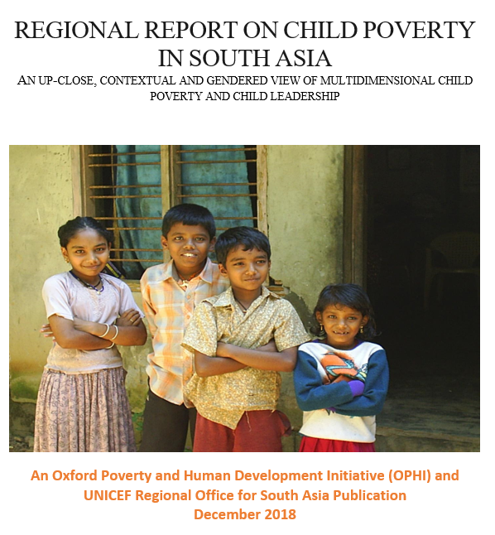
South Asia Child Poverty
OPHI & ROSA
Alkire, Ul-Haq, Alim

Slide 21
Child MPI that directly links to National MPI
Use the National MPI as it is.
From the survey, construct ‘new’ child dimension(s)
Use 2+ comparable indicators to cover children 0-17
Restrict the sample to children.
Compute the Child MPI – it shows additional child-specific deprivations of poor children. It also identifies children who are not MPI poor but are child poor.

Slide 22
Nepal C-MPI*
Dimensions | Indicators | Weight National MPI (k=1/3) | Weight C-MPI (k=1/4)
Education | Years of Schooling | 1/6 | 1/8
 | Child School Attendance | 1/6 | 1/8
Health | Child Mortality | 1/6 | 1/8
 | Nutrition | 1/6 | 1/8
Living Standard | Electricity | 1/18 | 1/24
 | Improved Sanitation | 1/18 | 1/24
 | Improved Drinking Water | 1/18 | 1/24
 | Housing | 1/18 | 1/24
 | Cooking Fuel | 1/18 | 1/24
 | Assets Ownership | 1/18 | 1/24
Child | Child Development |  | 1/8
 | Childhood Conditions |  | 1/8
* Draws on work in progress with Ana Vaz and Chris Oldiges
Notes:
The Nepal national measure follows the indicators of the Global MPI, having three dimensions and ten indicators such as malnutrition, low education, or inadequate sanitation. Using the latest data from the Multiple Indicator Cluster Survey (MICS) 2014, it adapts the Global MPI to national needs, for example in the case of Nepal to include roofing materials.

Slide 23
Child poverty: the urge to integrate
Ownership: Most countries spend 1-3 years building political consensus and statistical skill to make a permanent official MPI
Would this be possible for ‘Child-MPI’?
Policy use: Most national MPIs are used for policy design, coordination, for budget allocation, targeting and coordination.
Would a Child-MPI be used? Would it conflict with Nat’l?
Simplicity: There is a real concern of ‘statistical overload’ – having a national and child MPI could confuse so dampen action.
Could a C-MPI be linked to Nat’l MPI?

Slide 24
Child Poverty & National MPI: 4 Strategies
ALWAYS Include key Child Indicators in National MPI
ALWAYS Disaggregate the National MPI by age
ALWAYS Do Intrahousehold Analysis (age, gender)
Use a Child MPI that directly links to National MPI

Slide 25
THANK YOU

